Slide 1
P2P

Slide 2
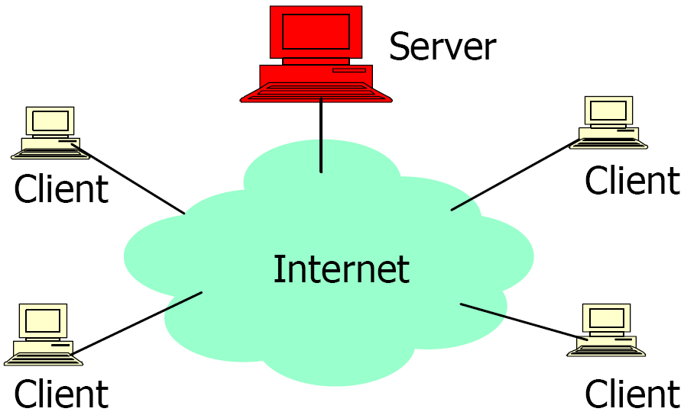
Client/Server Architecture
Well known, powerful, reliable server is a data source
Clients request data from server
Very successful model
WWW (HTTP), FTP, etc.
As more clients are added, the demand on
the server increases!!!

Slide 3
Client/Server Limitations
Scalability is hard to achieve
Presents a single point of failure
Requires administration
Unused resources at the network edge (client side)
CPU cycles, storage, etc.
P2P systems try to address these limitations

Slide 4
“I want to
collaborate
with my
colleague”
“I want to access
some information”
Client
Server
Peer-to-peer
Client/server

Slide 5
Distinctions
Client-server
Asymmetric relationship
Client predominately makes requests, server makes replies
Peer-to-peer
Symmetric relationship in many cases

Slide 6
Peer-to-peer (P2P)
Use the vast resources of machines at the edge of the Internet to build a network that allows resource sharing with limited central authority.
More than a system for sharing pirated music/movies

Slide 7
Peer-to-peer architecture

Slide 8
Characteristics of P2P Systems
Exploit edge resources.
Storage, content, CPU, Human presence.
Significant autonomy from any centralized authority.
Each node can act as a Client as well as a Server.
Resources at edge have unstable connectivity, constantly being added & removed.
Infrastructure is untrusted and the components are unreliable.

Slide 9
Overlay Network
A P2P network is an overlay network. Each link between peers consists of one or more IP links.

Slide 10
Category of P2P Systems
Unstructured
No restriction on overlay structures and data placement
Napster, Gnutella, KazaA, BitTorrent
Structured
Distributed hash tables (DHTs)
Place restrictions on overlay structures and data placement
Chord, and others

Slide 11
Unstructured P2P

Slide 12
Lookup Issue
How do you locate data/files/objects in a large P2P system built around a dynamic set of nodes in a scalable manner?
Efficient routing even if the structure of the network is unpredictable.
Napster, Gnutella, KaZaA, BitTorrent

Slide 13
Napster
Share Music files, MP3 data
Nodes register their contents (list of files) and IPs with server
Centralized server for searches
The client sends queries to the centralized server for files of interest
Keyword search (artist, song, album, bitrate, etc.)
Napster server replies with IP address of users with matching files
File download done on a peer-to-peer basis
Client
Client
Server
Reply
Query
File Transfer
Discussion: What are the disadvantages of this Napster structure?
Please go to
PollEv.com/cisgvsu429

Slide 14
Napster
Disadvantages
Poor scalability
Single point of failure
Legal issues

Slide 15


Napster: Publish
insert(X,
123.2.21.23)
...
Publish
I have X, Y, and Z!
123.2.21.23

Slide 16
Napster: Search
123.2.0.18
search(A)
-->
123.2.0.18
Fetch
Query
Reply
Where is file A?

Slide 17
Gnutella: Query Flooding
Breadth-First Search (BFS)
= source
= forward
query
= processed
query
= found
result
= forward
response

Slide 18
Gnutella: Query Flooding
A node/peer connects to a set of Gnutella neighbors
Forward queries to neighbors
Discussion: Please provide one advantage and one disadvantage of query flooding.
Please go to
PollEv.com/cisgvsu429

Slide 19
Gnutella: Query Flooding
Pro: Results are complete
Con: Bandwidth wastage
Flood network with TTL (Time-To-Live) for termination

Slide 20
KaZaA (FastTrack Networks)
Hybrid of centralized Napster and decentralized Gnutella
Super-peers act as local search hubs
Each super-peer is similar to a Napster server for a small portion of the network
Super-peers are automatically chosen by the system based on their capacities (storage, bandwidth, etc.) and availability (connection time)
Users upload their list of files to a super-peer
Super-peers periodically exchange file lists
You send queries to a super-peer for files of interest
The local super-peer may flood the queries to other super-peers for the files of interest, if it cannot satisfy the queries.
Exploit the heterogeneity of peer nodes

Slide 21
KaZaA: Network Design
“Super Nodes”

Slide 22
KaZaA: File Insert
insert(X,
123.2.21.23)
...
Publish
I have X!
123.2.21.23

Slide 23
KaZaA: File Search
search(A)
-->
123.2.22.50
search(A)
-->
123.2.0.18
123.2.22.50
Query
Replies
Where is file A?
123.2.0.18

Slide 24
BitTorrent
A popular P2P application for file exchange!
Problems to Address
Traditional Client/Server Sharing
Performance deteriorates rapidly as the number of clients increases
Free-riding in P2P network
Free riders only download without contributing to the network.

Slide 25
Basic Idea
Chop file into many pieces
A piece is broken into sub-pieces ... typically 16KB in size
Policy: Until a piece is assembled, only download sub-pieces for that piece
This policy lets complete pieces assemble quickly
Replicate DIFFERENT pieces on different peers as soon as possible
As soon as a peer has a complete piece, it can trade it with other peers
Hopefully, we will be able to assemble the entire file at the end

Slide 26
File Organization
File
1
2
3
4
Piece 256KB
Block 16KB
Incomplete Piece

Slide 27
Overall Architecture
Web Server
Tracker
Web page
with link
to .torrent
.torrent
C
A
Peer
[Seed]
Peer
[Leech]
Downloader
“US”
B
Peer
[Leech]

Slide 28
Overall Architecture
Web Server
Tracker
Web page
with link
to .torrent
Get-announce
C
A
Peer
[Seed]
Peer
[Leech]
Downloader
“US”
B
Peer
[Leech]

Slide 29
Overall Architecture
Web Server
Tracker
Web page
with link
to .torrent
Response-peer list
C
A
Peer
[Seed]
Peer
[Leech]
Downloader
“US”
B
Peer
[Leech]

Slide 30
Overall Architecture
Web Server
Tracker
Web page
with link
to .torrent
Shake-hand
C
A
Peer
[Seed]
Peer
[Leech]
Downloader
“US”
Shake-hand
B
Peer
[Leech]

Slide 31
Overall Architecture
Web Server
Tracker
Web page
with link
to .torrent
pieces
C
A
pieces
Peer
[Seed]
Peer
[Leech]
Downloader
“US”
B
Peer
[Leech]

Slide 32
Overall Architecture
Web Server
Tracker
Web page
with link
to .torrent
pieces
C
A
pieces
Peer
[Seed]
Peer
[Leech]
Downloader
“US”
pieces
B
Peer
[Leech]

Slide 33
Overall Architecture
Web Server
Tracker
Web page
with link
to .torrent
Get-announce
Response-peer list
pieces
C
A
pieces
Peer
[Seed]
Peer
[Leech]
Downloader
“US”
pieces
B
Peer
[Leech]

Slide 34
Critical Elements
1) A web server
To provide the ‘metainfo’ file by HTTP
Web Server
The Lord of Ring.torrent
Troy.torrent

Slide 35
Critical Elements
2) The .torrent file
Static ‘metainfo’ file to contain necessary information :
Name
Size
Checksum
IP address (URL) of the Tracker
Pieces <hash₁,hash₂,….hash_{n}>
Piece length
Matrix.torrent

Slide 36
Critical Elements
3) A BitTorrent tracker
Non-content-sharing node
Track peers
Peer cache
IP, port, peer id
State information
Completed
Downloading
Returns random list

Slide 37
Critical Elements
4) An end user (peer)
Users who want to use BitTorrent must install corresponding software or plug-in for web browsers.
Downloader (leecher) : Peer has only a part (or none) of the file.
Seeder: Peer has the complete file, and chooses to stay in the system to allow other peers to download

Slide 38
Messages
Peer – Peer messages
TCP Sockets
Peer – Tracker messages
HTTP Request/Response

Slide 39
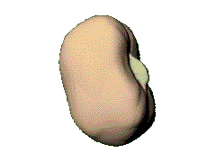

BitTorrent – joining a torrent
metadata file
.torrent
new leecher
website
1
2
join
peer list
3
data request
seed/leecher
tracker
4
Peers divided into:
seeds: have the entire file
leechers: still downloading
1. obtain the metadata file
2. contact the tracker
3. obtain a peer list (contains seeds & leechers)
4. contact peers from that list for data

Slide 40


BitTorrent – exchanging data
leecher B
leecher A
I have
!
seed
leecher C
● Verify pieces using hashes
● Download sub-pieces in parallel
● Advertise received pieces to the entire peer list
● Look for the rarest pieces

Slide 41
BitTorrent - unchoking
leecher B
leecher A
seed
leecher C
leecher D
● Periodically calculate data-receiving rates
● Upload to (unchoke) the fastest downloaders/uploaders
● Optimistic unchoking
periodically select a peer at random and upload to it
continuously look for the fastest partners

Slide 42

Example
HTTP GET MYFILE.torrent
MYFILE.torrent
webserver
http://mytracker.com:6969/
S3F5YHG6FEB
FG5467HGF367
F456JI9N5FF4E
…
“register”
user
list of peers
ID1 169.237.234.1:6881
ID2 190.50.34.6:5692
ID3 34.275.89.143:4545
…
ID50 231.456.31.95:6882
tracker
…
Peer 1
Peer 2
Peer 40

Slide 43
Pieces and Sub-pieces
A piece, typically 256KB is broken into 16KB sub-pieces.
Until a piece is assembled, only sub-pieces for that piece is downloaded.
This ensures that complete pieces assemble quickly.
At any point in time, some number, typically 5, are requested simultaneously.
On piece completion, notify all (neighbor) peers.

Slide 44
Piece Selection
The order of pieces is very important for good performance.
A bad algorithm could result in all peers waiting for the same missing piece.
Random Piece First policy
Initially a peer had no pieces to trade, thus important to get a piece ASAP.
Policy: Peer starts with a random piece to download.
Rarest Piece First policy
Policy: Download the pieces which are rarest among your peers.
Ensures most common pieces are left for last.

Slide 45
Distributed Hash Table (DHT)
and
Structured P2P

Slide 46
Motivation
How to find data in a distributed file sharing system?
N₂
N₃
Publisher
N₁
Key=“LetItBe”
Value=MP3 data
Internet
N₅
?
N₄
Client
Lookup(“LetItBe”)
Lookup is the key problem

Slide 47
Centralized Solution
Central server (Napster)
N₂
N₃
Publisher
N₁
Key=“LetItBe”
Value=MP3 data
Internet
DB
N₅
N₄
Client
Lookup(“LetItBe”)
Requires O(N) state
Single point of failure

Slide 48
Distributed Solution (1)
Flooding (Gnutella, etc.)
N₂
N₃
Publisher
N₁
Key=“LetItBe”
Value=MP3 data
Internet
N₅
N₄
Client
Lookup(“LetItBe”)
Worst case O(N) messages per lookup

Slide 49
Distributed Solution (2)
Routed messages (Chord, etc.)
N₂
N₃
Publisher
N₁
Key=“LetItBe”
Value=MP3 data
Internet
N₅
N₄
Client
Lookup(“LetItBe”)
Only exact matches

Slide 50
Routing Challenges
Define a useful key nearness metric
Keep the hop count small
Keep the routing tables “right size”
Stay robust despite rapid changes in membership
Chord: emphasizes efficiency and simplicity

Slide 51
Chord IDs
m bit identifier space for both keys and nodes
Key identifier = SHA-1(key)
Key=“LetItBe”
SHA-1
ID=60
Node identifier = SHA-1(IP address)
IP=“198.10.10.1”
SHA-1
ID=123
Both are uniformly distributed
How to map key IDs to node IDs?

Slide 52
Consistent Hashing [Karger 97]
0
K5
IP=“198.10.10.1”
N123
K20
Circular 7-bit
ID space
K101
N32
N90
Key=“LetItBe”
K60
A key is stored at its successor: node with next higher ID

Slide 53
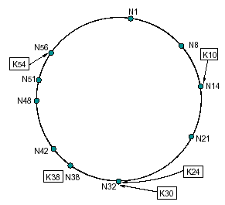
Consistent Hashing: An Example
For m = 6, # of identifiers is 64.
The following Chord ring has 10 nodes and stores 5 keys.
The successor of key 10 is node 14.

Slide 54
Lookup Approaches
Naïve
Successor one by one
Chord (“Finger Table”)

Slide 55
Lookup: Naïve Approach
Every node knows of every other node
requires global information
Routing tables are large O(N)
Lookups are fast O(1): Hash(key) -> index of the table
0
N10
Where is “LetItBe”?
Hash(“LetItBe”) = K60
N123
N32
“N90 has K60”
K60
N90
N55

Slide 56
Lookup: Successor one by one
Every node knows its successor in the ring
0
N10
Where is “LetItBe”?
N123
Hash(“LetItBe”) = K60
N32
“N90 has K60”
K60
N90
N55
requires O(N) time

Slide 57
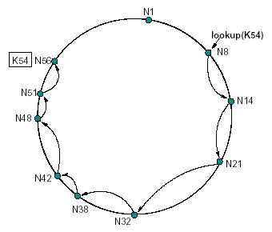
An example: A Simple Key Lookup (successor one by one)
The path taken by a query from node 8 for key 54:

Slide 58
Lookup: Chord (“Finger Tables”)
Every node knows m other nodes in the ring
m: log(N)
Increase distance exponentially
N112
N16
80 + 2⁵
80 + 2⁶
Finger i points to successor of n+2^{i-1} , i = 1, 2 ,…, m. (m=7 in this figure)
m entries in the finger table
N96
80 + 2⁴
80 + 2³
80 + 2²
80 + 2¹
80 + 2⁰
N80

Slide 59
Chord finger tables
Principle
Each node p maintains a finger table FT_{p} [] with at most m entries:
FT_{p} [i ] = succ(p + 2^{i−1})
Note: the i -th entry points to the first node succeeding p by at least 2^{i−1}. To look up a key k , node p forwards the request to node with index j
satisfying
q = FT_{p} [j ] ≤ k < FT_{p} [j + 1]
If p < k < FT_{p} [1], the request is also forwarded to FT_{p} [1]

Slide 60
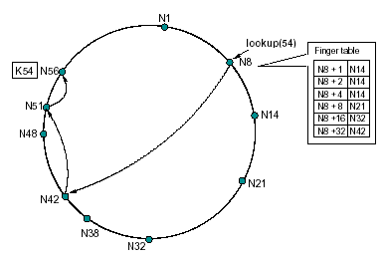
Chord Key Location – Example query
The path a query for key 54 starting at node 8:
m=6, N=64
N51+1: N56
N51+2: N56
N51+4: N56
...
N42+1: N48
N42+2: N48
N42+4: N48
N42+8: N51
N42+16: N1
N42+32: N14
Notes:
Finger table of N42:
N42+1: N48
N42+2: N48
N42+4: N48
N42+8: N51
N42+16: N1
N42+32: N14
Partial finger table of N51:
N51+1: N56
N51+2: N56
N51+4: N56

Slide 61
Lookups are Faster
N5+1 N20
N5+2 N20
N5+4 N20
N5+8 N20
N5+16 N32
N5+32 N60
N5+64 N80
Lookups take O(Log N) hops
m=7, N=128
N5
N110
N99+1 N110
N99+2 N110
N99+4 N110
N99+8 N110
N99+16 N5
N99+32 N5
N99+64 N60
N20
K19
N99
N32
Lookup(K19)
N32+1 N60
N32+2 N60
N32+4 N60
N32+8 N60
N32+16 N60
N32+32 N80
N32+64 N99
N80
N60

Slide 62
Exercise
We assume there are 32 possible nodes (m=5, N=32, node 0 to node 31) in the Chord system. Currently, the nodes 1, 4, 9, 11, 14, 18, 20, 21, 28 exist in the network.
From node 1, we want to search key 26. What are the intermediate nodes the system has to go through to find key 26? (We need to build the finger tables of the current live nodes first.)
Please go to
PollEv.com/cisgvsu429

Slide 63
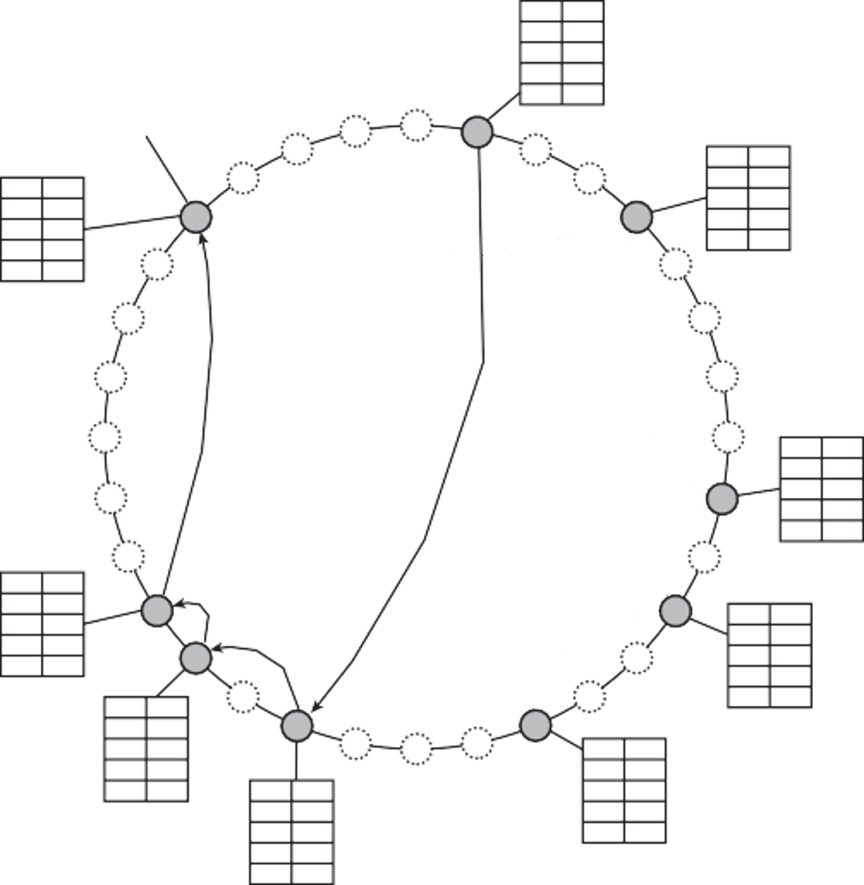
Chord lookup example
Resolving key 26 from node 1, m=5, N=32
N1+1 4
N1+2 4
N1+4 9
N1+8 9
N1+16 18
succ(p + 2^{i-1} )
Actual node
31
0
1
30
2
N4+1 9
N4+2 9
N4+4 9
N4+8 14
N4+16 20
N28+1 1
N28+2 1
N28+4 1
N28+8 4
N28+16 14
29
3
28
4
27
5
26
6
25
7
24
8
N9+1 11
N9+2 11
N9+4 14
N9+8 18
N9+16 28
23
Resolve k = 26 from node 1
9
22
10
N21+1 28
N21+2 28
N21+4 28
N21+8 1
N21+16 9
21
11
N11+1 14
N11+2 14
N11+4 18
N11+8 20
N11+16 28
20
12
N20+1 21
N20+2 28
N20+4 28
N20+8 28
N20+16 4
19
13
18
17
16
15
14
N14+1 18
N14+2 18
N14+4 18
N14+8 28
N14+16 1
N18+1 20
N18+2 20
N18+4 28
N18+8 28
N18+16 4
Notes:
K=26 from node 1
26 > FT1[5] so we go to Node 18
FT18[2] <= k < FT18[3] so we go with FT18[2] which is 20
FT20[1] <= k < FT18[2] so we go with FT20[1] which is 21
FT21[1] > k so we go to FT21[1] which is 28 and there we find our data.

Slide 64
Consistent Hashing – Join and Departure
When a node n joins the network, certain keys previously assigned to n’s successor now become assigned to n.
When node n leaves the network, all of its assigned keys are reassigned to n’s successor.

Slide 65
Joining the Ring
Three step process:
Initialize all fingers of new node
Update fingers of existing nodes
Transfer keys from successor to new node

Slide 66
Joining the Ring - Step 1
Initialize the new node finger table
Locate any node p in the ring
Ask node p to lookup fingers of new node N36
Return results to new node
N5
N20
N36
N99
1. Lookup(37,38,40,…,100,164)
N40
Here, 37=36+2⁰; 38=36+2¹; 40=36+2²
…; 100=36+2⁶
164=36+2⁷
N80
N60

Slide 67
Joining the Ring - Step 2
Updating fingers of existing nodes
new node calls update function on existing nodes
existing nodes can recursively update fingers of other nodes
N5
N20
N99
N36
N40
N80
N60

Slide 68
Joining the Ring - Step 3
Transfer keys from successor node to new node
only keys in the range are transferred
N5
N20
N99
N36
K30
Copy keys 20…35
from N40 to N36
N40
K38
N80
N60

Slide 69
Handling failures: redundancy
N5
N10
N110
K19
N20
N99
K19
N32
N40
K19
N80
N60
Each node knows IP addresses of next r nodes
Each key is replicated at next r nodes

Slide 70
Applications
The idea of Chord has been widely adopted in many decentralized data storage applications, including:
Amazon Dynamo
Facebook Cassandra
LinkedIn Voldemort

